Slide 1
Funding entity
What is the funding entity?
What are the type of funding pages?
How does the funding entity work?
What is the funding plan sub-tab?
How does the funding sub-tab look like?
How does the funding sub-tab work?
What is the allocations sub-tab?
How does the allocation sub-tab look like?
How does the allocation sub-tab work?
What is the income schedule tab?
How does the income schedule look like?

Slide 2
What is the funding entity?
Funding pages provide a space to track funding opportunities and proposals to institutional donors, and to manage restricted and unrestricted funding sources
The Funding Browse list has been designed to show key information about the funding pipeline, providing users with visibility of what is being tracked vs applied for vs secured
The Funding Workflow rules the life cycle of a funding opportunity from its initial detection to the closure of the related donor-funded project
In the Funding Workflow all steps that are related to the respective funding opportunity and the communication with the donor are managed.

Slide 3
What are the type of funding pages?
 | Type | Description | Cycle tab | Functionality Finance tab
Restricted Funding pages | Institutional funds | LCDF funds for ex. EU/BMZ funds, larger foundations | Funding cycle | Funding plan Allocation Income schedule
 | Major donor funds | Individual private donations, normally with a high amount and/or with specific donor requirements. | Funding cycle | Funding plan Allocation Income schedule
Unrestricted Funding Pages | Free funds | Baseline | No funding cycle | Allocation

Slide 4
How does the funding entity work?
Funding Workflows are managed by the IDP/IDD (Identification, Proposal Development, Contracting) and PD teams (Implementation, Conclusion of funding)
Only Administrators and ‘Funding creators’ can create a new Funding page.
New funding pages must be linked to a donor in the stakeholder entity.
The workflow type is determined by the ‘Workflow type’ field.
The content of the finance tab is determined by the ‘Funding type’ field.
The years shown in the Finance tab are pulled from the start/end dates identified in the Funding form.
Different fields in the form become mandatory depending on the status of the page
Allocation of funds is always done only from a Funding page to a Project page

Slide 5
What is the funding plan sub-tab?
The ‘Funding plan’ sub-tab in the Finance tab appears only on the institutional funds or major donor funds type of pages.
It provides a space to capture the total incoming Funding from a donor broken down by year and cost category (e.g. direct costs vs overheads) as well as any other match-funding sources.
The funding and cost structure breakdown are entered in donor currency, which are then converted to system currency (EUR) using the central exchange rate table
The Funding plan can be saved as a draft or confirmed to publish a new version
To create a new draft version, select the next available draft version from the ‘Version’ drop-down

Slide 6
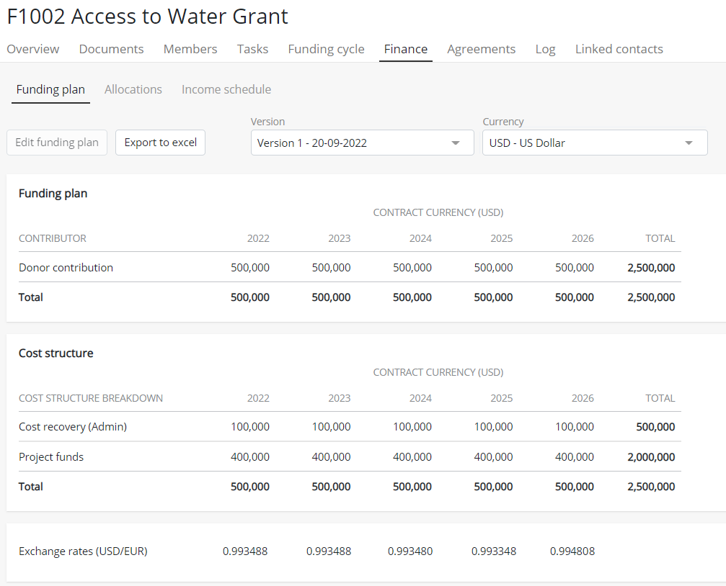
How does the funding plan sub-tab look like?
Version
Currency filter
(donor currency or system currency)
Funding plan: Income from the donor by year
Cost structure: breakdown by cost structure
Exchange rates: exchange rates applied to convert the values

Slide 7
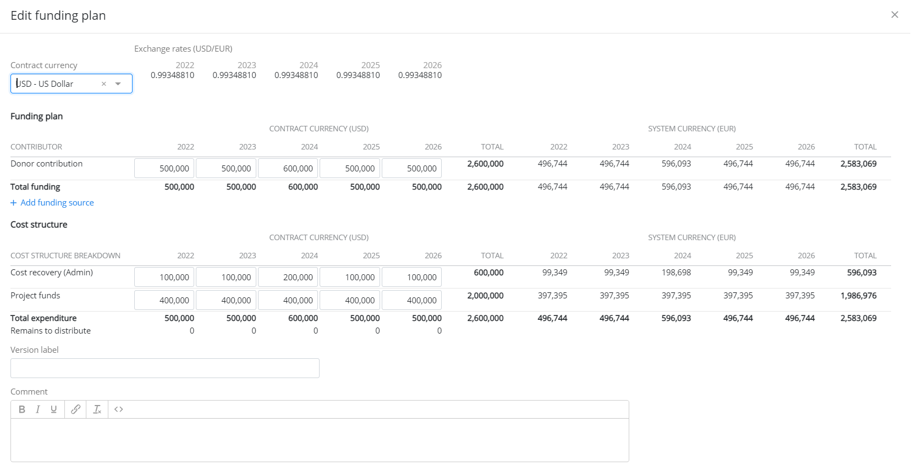
How does the funding plan sub tab work?
System currency: automatically converted
Donor contribution: add the donor contribution per year of the contract (and any match-funding sources)
Cost structure: add the total funding broken down by cost structure
Version label: add a custom version label, if applicable
Comment: add any relevant notes

Slide 8
What is the allocations sub-tab?
The ‘Allocations’ sub-tab appears on both Restricted and Unrestricted Funding pages but in slightly different versions.
The tab provides a space to manage allocations from a Funding page to Projects within the system.
Allocations can be saved as preliminary or confirmed directly.
On Restricted Funding pages, allocations cannot be sent unless there is a published Funding plan in place
On Unrestricted Funding pages, allocations cannot be sent unless there is available balance (managed via the Admin Portal)

Slide 9
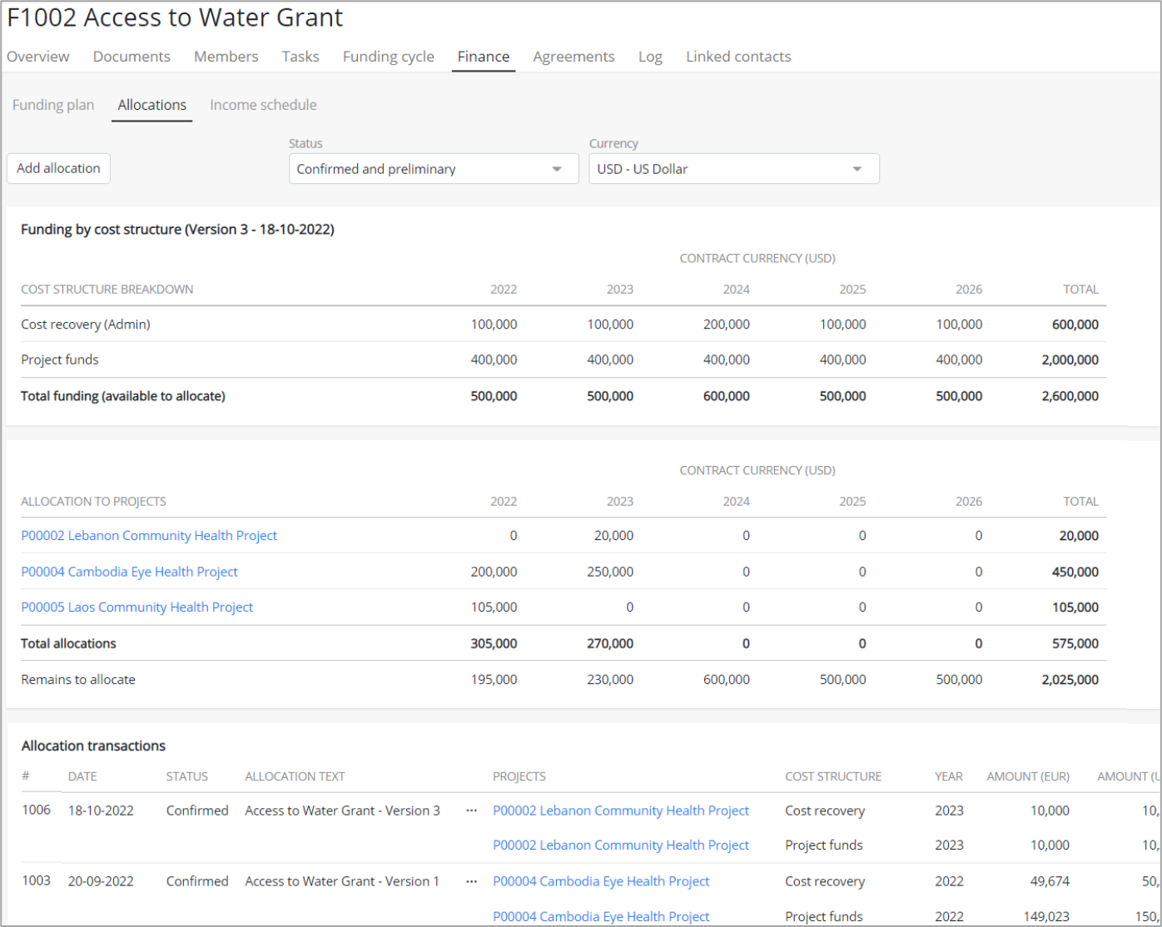
How does the allocation sub-tab look like?
Status: preliminary vs confirmed allocations
Currency filter
(donor currency or system currency)
Cost structure breakdown: funding summary (different layout between Restricted vs Unrestricted Funding pages)
Allocation to projects: allocations made to projects (preliminary allocations appear in italics)
Allocation transaction details

Slide 10
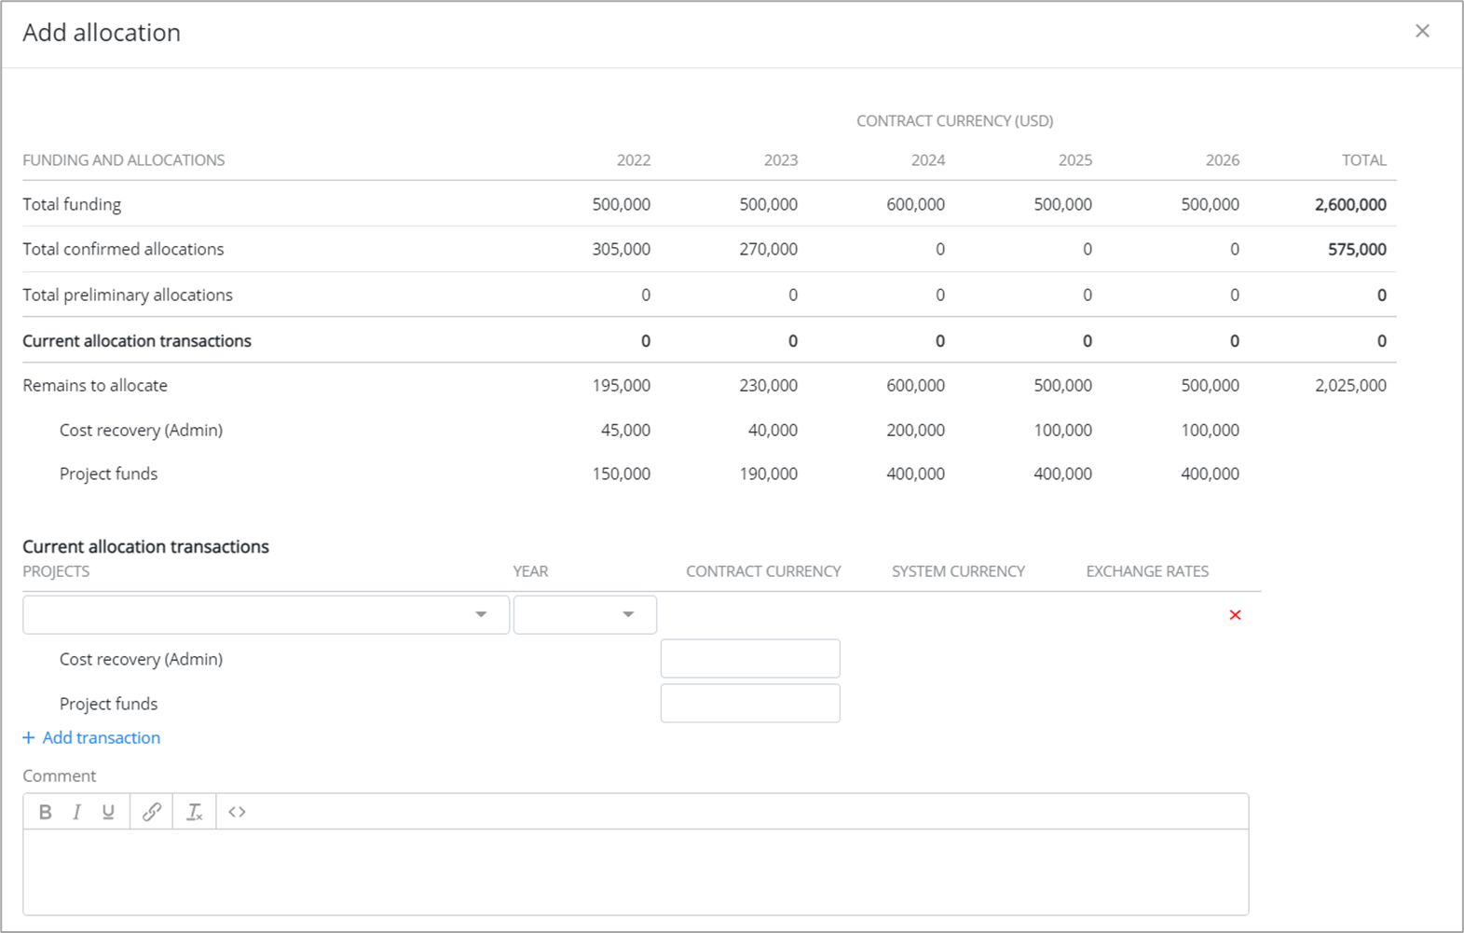
How does the allocation sub-tab work?
Funding and allocations: shows a summary of the available funding (different layout between restricted vs unrestricted Funding pages)
Current allocation transactions: Click ‘+Add transaction’, select the Project and then enter the allocation totals (broken down by cost structure)
Comment: Any relevant notes can be added

Slide 11
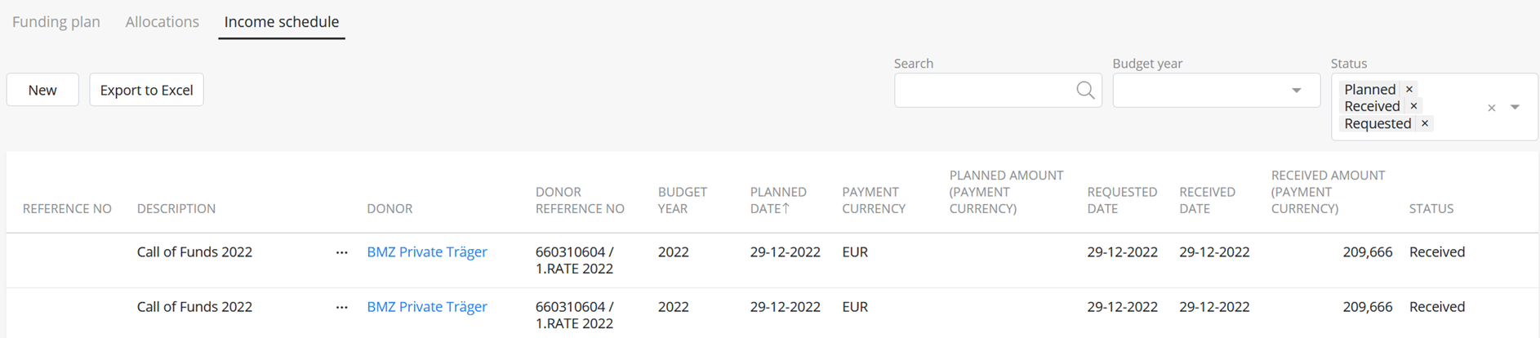
What is the income schedule tab?
The ‘Income schedule’ sub-tab appears only on Restricted Funding pages
This sub-tab allows users to captures the income schedule for the grant/contract, including the planned payment dates and amounts vs the dates and amounts requested and received.
Entries in the Income schedule do not require approval and can be edited as needed.

Slide 12
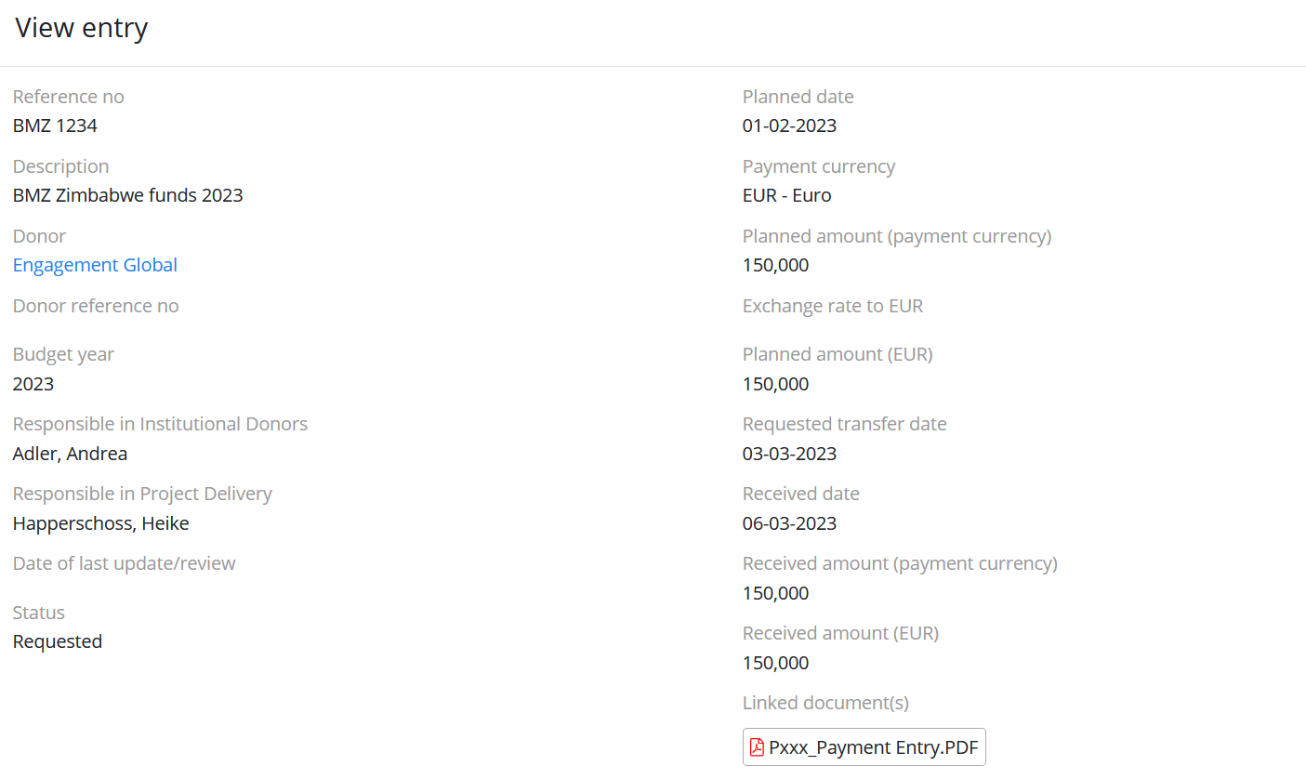
How does the income schedule look like?
Each entry represents a payment from a donor that is:
First planned (with a planned date and amount)
Second requested from the donor
Finally received (with a specific date and amount)

